Slide 1
Zoom Breakout Rooms
DKG

Slide 2
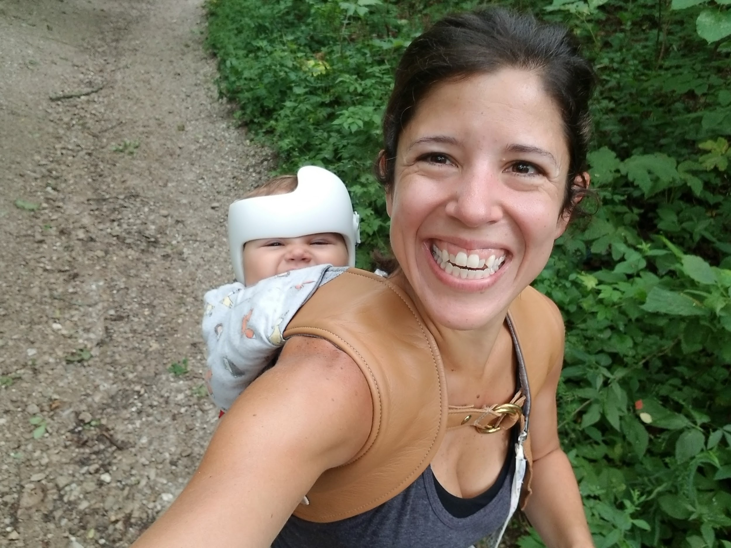
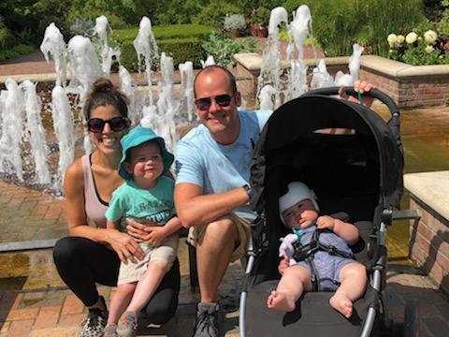
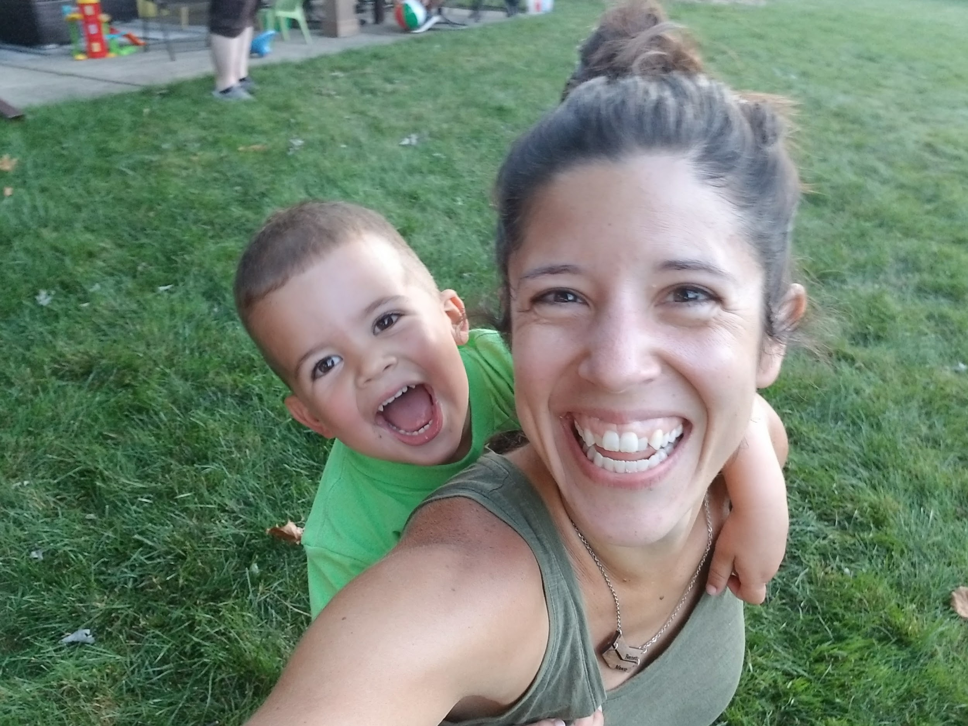
Kim Malinowski
HELLO! I’m...
Technology Integration Facilitator at Thomas Middle School in Arlington Heights.
DKG - Alpha Delta Chapter

Slide 3
What are Zoom Breakout Rooms?

Slide 4
Breakout Rooms in Zoom -
Today’s Plan:
Setting up breakout rooms
Joining breakout rooms
Host/Co-host abilities during breakout rooms

Slide 5
Enable Breakout Rooms
Zoom.us -
“Settings” -
Meeting (Advanced) -
Enable rooms

Slide 6
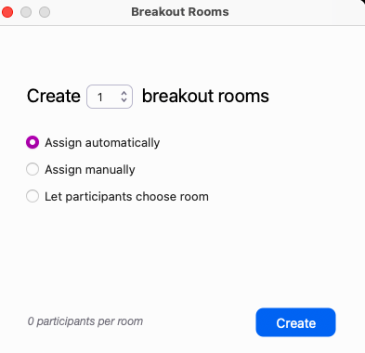
Create Rooms
Click on the Breakout Rooms icon in the menu bar
Decide how many rooms you will need
Decide how you will assign participants:
Assign Automatically (randomly assigns equal number of participants to rooms)
Assign Manually (YOU must put people in rooms)
Let Participants Choose (participants choose which room they want to be in and can hop from room to room)
Click Create!

Slide 7
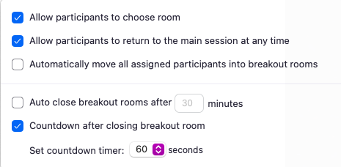
Zoom Breakout Room Options
BEFORE you open all rooms, you have a few options for your settings:
If allowing to choose room, that option will be checked
Decide if participants can return to main session at any time or if they are locked into their breakout room
Automatically move assigned participants to room (only works for manual and automatic assignment options)

Slide 8
Zoom Breakout Room Options (cont.)
Only want participants in rooms for a specific amount of time? Choose to auto close rooms after ___ min
Decide how long participants have in the room once you close all rooms before they are automatically moved back to the main session

Slide 9
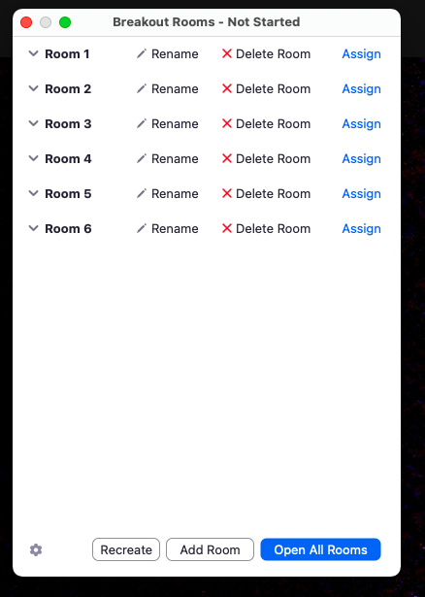
Assigning Automatically
Choose how many rooms you want
Choose “Assign Automatically”
Click Create
Adjust room settings
Click “Open All Rooms”

Slide 10
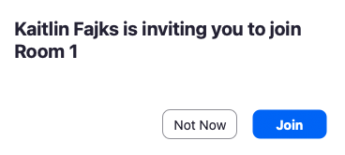
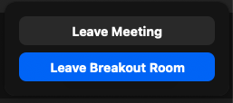
Let’s try it!
How to join a breakout room as a participant:
Click “Join” when it asks you to join a room
How to LEAVE a breakout room as a participant:
Click “Leave Room” at the bottom right of your screen - choose “Leave Breakout Room”
Notes:
Open rooms for 1 min

Slide 11
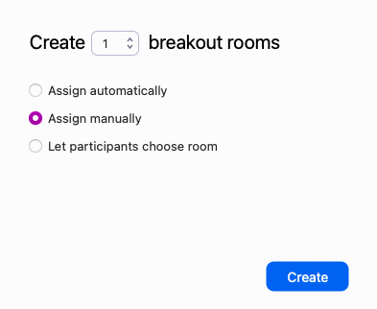
Assigning Manually
Choose how many rooms you want
Choose “Assign Manually”
Click Create
Assign participants to rooms
Click “Assign” next to each room - choose all participants who are going into that room
Adjust room settings
Click “Open All Rooms”
Once rooms are opened, you can still move participants around by hovering over their name in the room and clicking “Exchange” to move them to another room

Slide 12
Let’s try it!
Notes:
Open rooms for 1 min

Slide 13
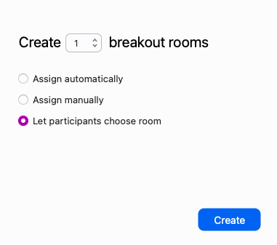
Let Participants Choose
Choose how many rooms you want
Choose “Let participants choose room”
Click Create
Adjust room settings
Click “Open All Rooms”

Slide 14
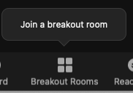
Let’s try it!
How to join a breakout room as a participant:
Click the breakout room icon - click “Join a breakout room”
Choose the room you want to join and click “Join”
Notes:
Open rooms for 1 min

Slide 15
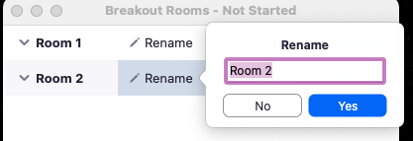
Extras
Adding a room:
BEFORE opening all rooms - click “Add Room”
Renaming Rooms:
Can do this BEFORE or AFTER rooms are opened
Click “Rename” next to a room
Write the new name for the room - click “Yes”

Slide 16
Let’s try it!
Notes:
Open rooms for 1 min - make room names for their favorite seasons (4 rooms)

Slide 17
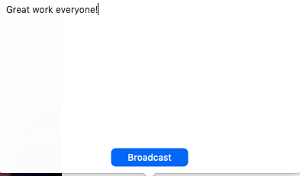
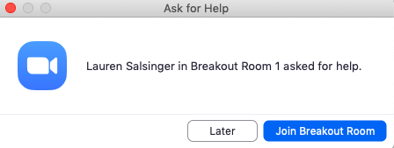
While rooms are open...
Send messages to rooms
Students can ask for help in rooms

Slide 18
Host vs Co-Host Abilities
HOST:
**If co-host did not create breakout rooms, they must go into an assigned room first before they are able to jump between rooms
CO-HOST:

Slide 19
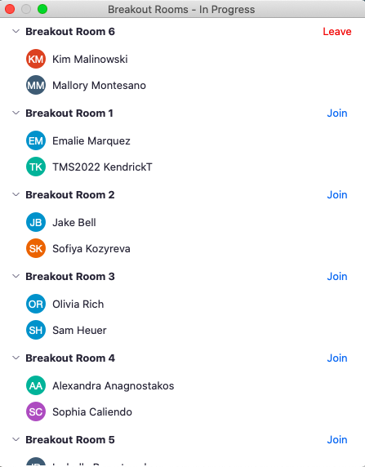
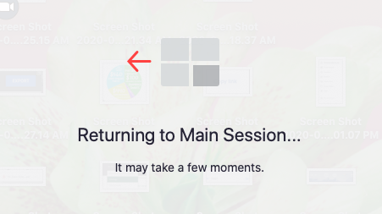
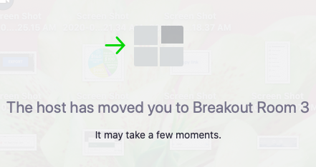
Co-Hosts
Must first join a room designated by the host
Can then jump room to room
Click on the Breakout room icon
Choose to leave room (go back to main session) OR
Join another room

Slide 20
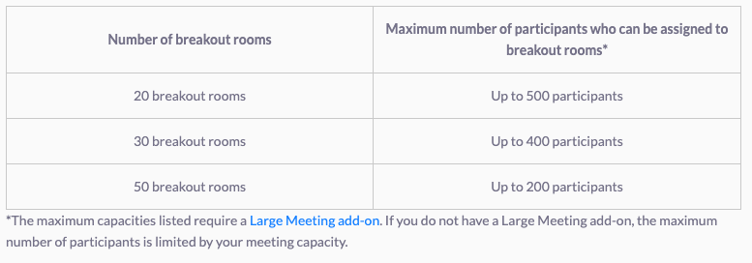
How many rooms can I have?

Slide 21
Pre-assigning Breakout Rooms
Must be a registered account
In order to pre-assign participants to rooms, all participants must have registered accounts
Enable this feature on Zoom.us

Slide 22
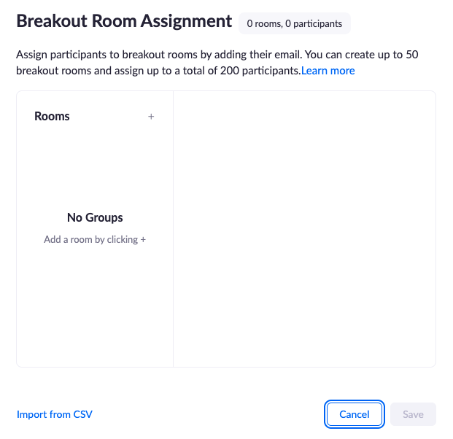
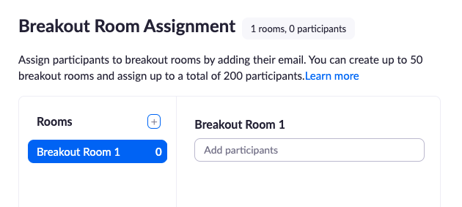
Pre-assigning Breakout Rooms (cont)
Schedule a meeting on Zoom.us - “Meetings” - “Schedule a Meeting”
Under “Meeting Options” - choose “Breakout Room pre-assign
Upload CSV file OR “Create Rooms”
Add participant registered emails

Slide 23
Breakout Room Limitations
In Zoom Meeting breakout rooms, breakout room participants have full access to screen share, chat, and audio (even if they are disabled in the main room).
Chat
Within each breakout room, attendees can chat with everyone in the breakout room or a specific person in the breakout room even if participant chat is disabled in the main room.
Breakout room chat is only viewable in that breakout room.
Main room chat does not show in breakout room chat.
Each time a breakout room is opened, the chat starts empty (it does not include a previous instance of the breakout room's chat nor the main room chat).
Anyone in a breakout room can click “Ask For Help” to request that the Host join the breakout room.
Share Screen
Within each breakout room, attendees can screen share even if screen share for attendees is disabled in the main room.
Only one person can share at a time in each breakout room (even if multiple people are allow to share simultaneously in the main room).

Slide 24
My email:
kamalinowski82@gmail.com

Slide 25
Thanks for joining me!

